Slide 1
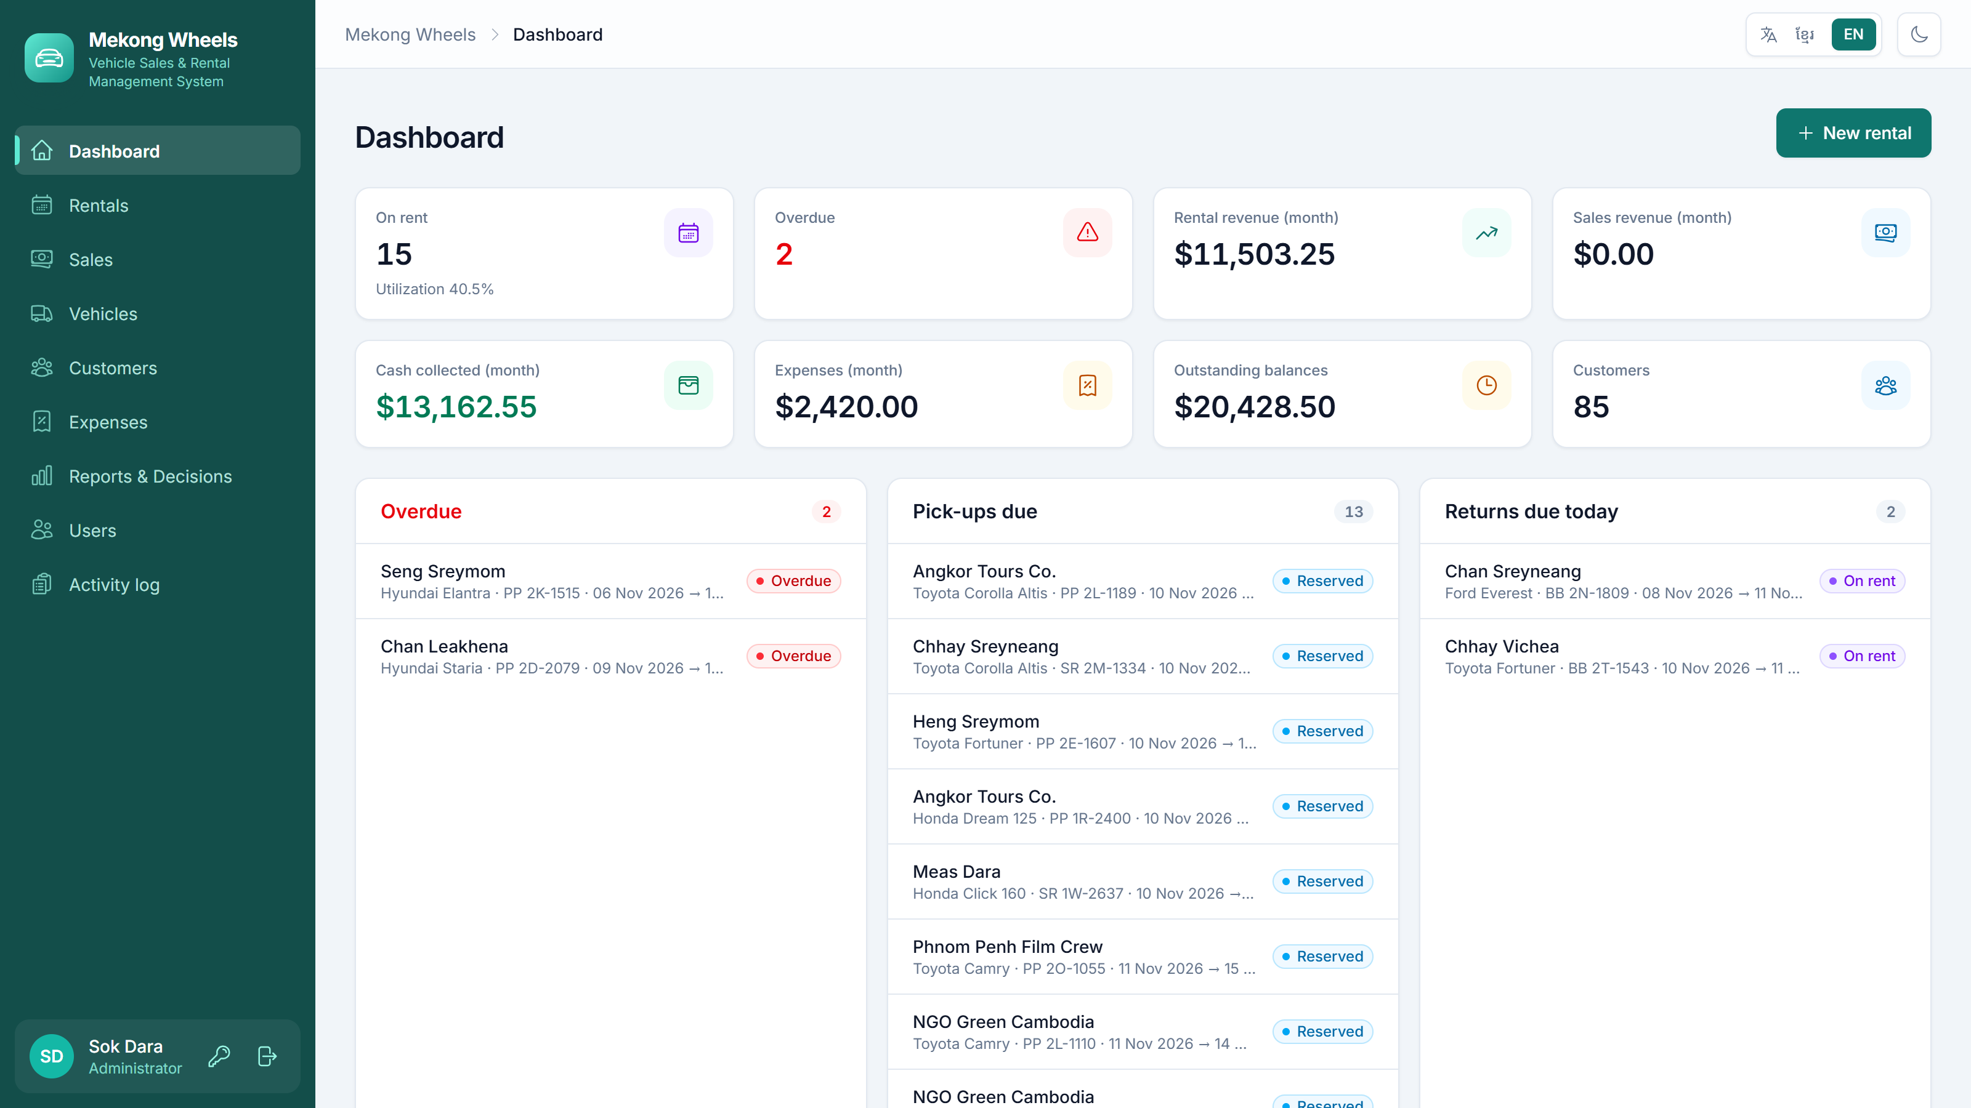
Mekong Wheels
Management Information Systems (MIS) Assignment
Vehicle Sales & Rental Management System
Lecturer: Pay Laten
Presented by Muy Saroth · November 2026
Notes:
Hello. Today we present Mekong Wheels, an MIS for a vehicle rental and sales company. The system really runs (Laravel + React); it is not just a paper design.

Slide 2






Agenda
01
02
03
Business case study
System design
Decision support
Problems · TPS / MIS / DSS · Recommendations
Architecture · Flowchart · ERD
Which vehicle type to invest in?
04
05
06
Excel data analysis
Process mapping
Live system demo
Dashboard · Trends · What-if
As-Is (manual) → To-Be (MIS)
Demo · Quality · Conclusion
Notes:
The talk follows the five parts of the assignment and ends with a live demo of the system.

Slide 3




Mekong Wheels tracks bookings on paper and in Excel
37
Double bookings
Slow answers
rental vehicles (5 types)
One vehicle booked for two customers — 2–3 times a month
“Is a car free?” takes 5–10 minutes
~1,900
rentals per year
Overdue cars missed
Buying cars on gut feeling
Late fees are lost; balances owed are unclear
No ROI or utilization data
$337K
rental revenue per year
Root cause: One booking lives in 3–4 places (book, invoice, Excel, Telegram) — no single source of truth
Notes:
Mekong Wheels is a fictional company with 37 rental vehicles. The main problems are double bookings, slow answers, unnoticed overdue rentals and buying vehicles without data. The root cause is that the same data lives in several places.

Slide 4



One system covers TPS · MIS · DSS
TPS
MIS
DSS
Records daily transactions
Summary reports for managers
Supports non-routine decisions
Rentals: book → pick up → return
Sales and instalments
Expenses and customers
Dashboard
Overdue cars / pick-ups due today
Revenue this month and balances owed
ROI and utilization
Investment score per vehicle type
Excel export + What-if
Before: Paper book & invoices
Before: Month-end Excel (1–2 weeks late)
Before: Gut feeling
Notes:
Each screen maps to a type of information system: TPS records transactions, MIS summarises for managers, DSS supports investment decisions.

Slide 5






Recommendations and expected results
Before (manual)
After (MIS)
Answering “Is a car free?”
5–10 minutes
< 30 seconds
Double bookings
2–3 a month
0 — the system refuses
Monthly report
~2 days
Instant
Balances owed
Unclear
Always visible
Basis for investment decisions
Gut feeling
12 months of data
Notes:
Key recommendations: a central database, automatic double-booking checks, a clear rental life cycle with automatic late fees, a daily dashboard, a DSS and role-based permissions. Result: answers ten times faster and no double bookings.

Slide 6
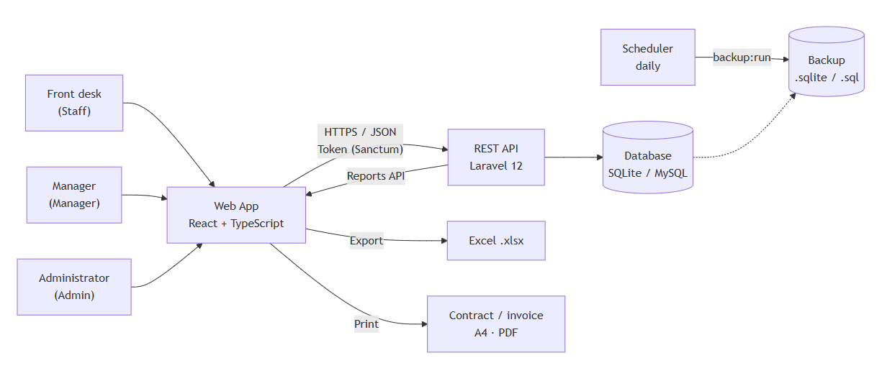



Architecture: Web App · REST API · Database
Web App
React 19 + TypeScript · 9 screens · Khmer / English · Dark mode
REST API
Laravel 12 · 3 permission levels · Audit log
Database
SQLite or MySQL · 8 tables · Daily backup
Data entered once — the dashboard, reports and Excel all read one database (single source of truth)
Notes:
Users in three roles use the web app, which calls the REST API over HTTPS with a token. All data lives in one database, so reports are always correct. A scheduler backs up the database every day.

Slide 7
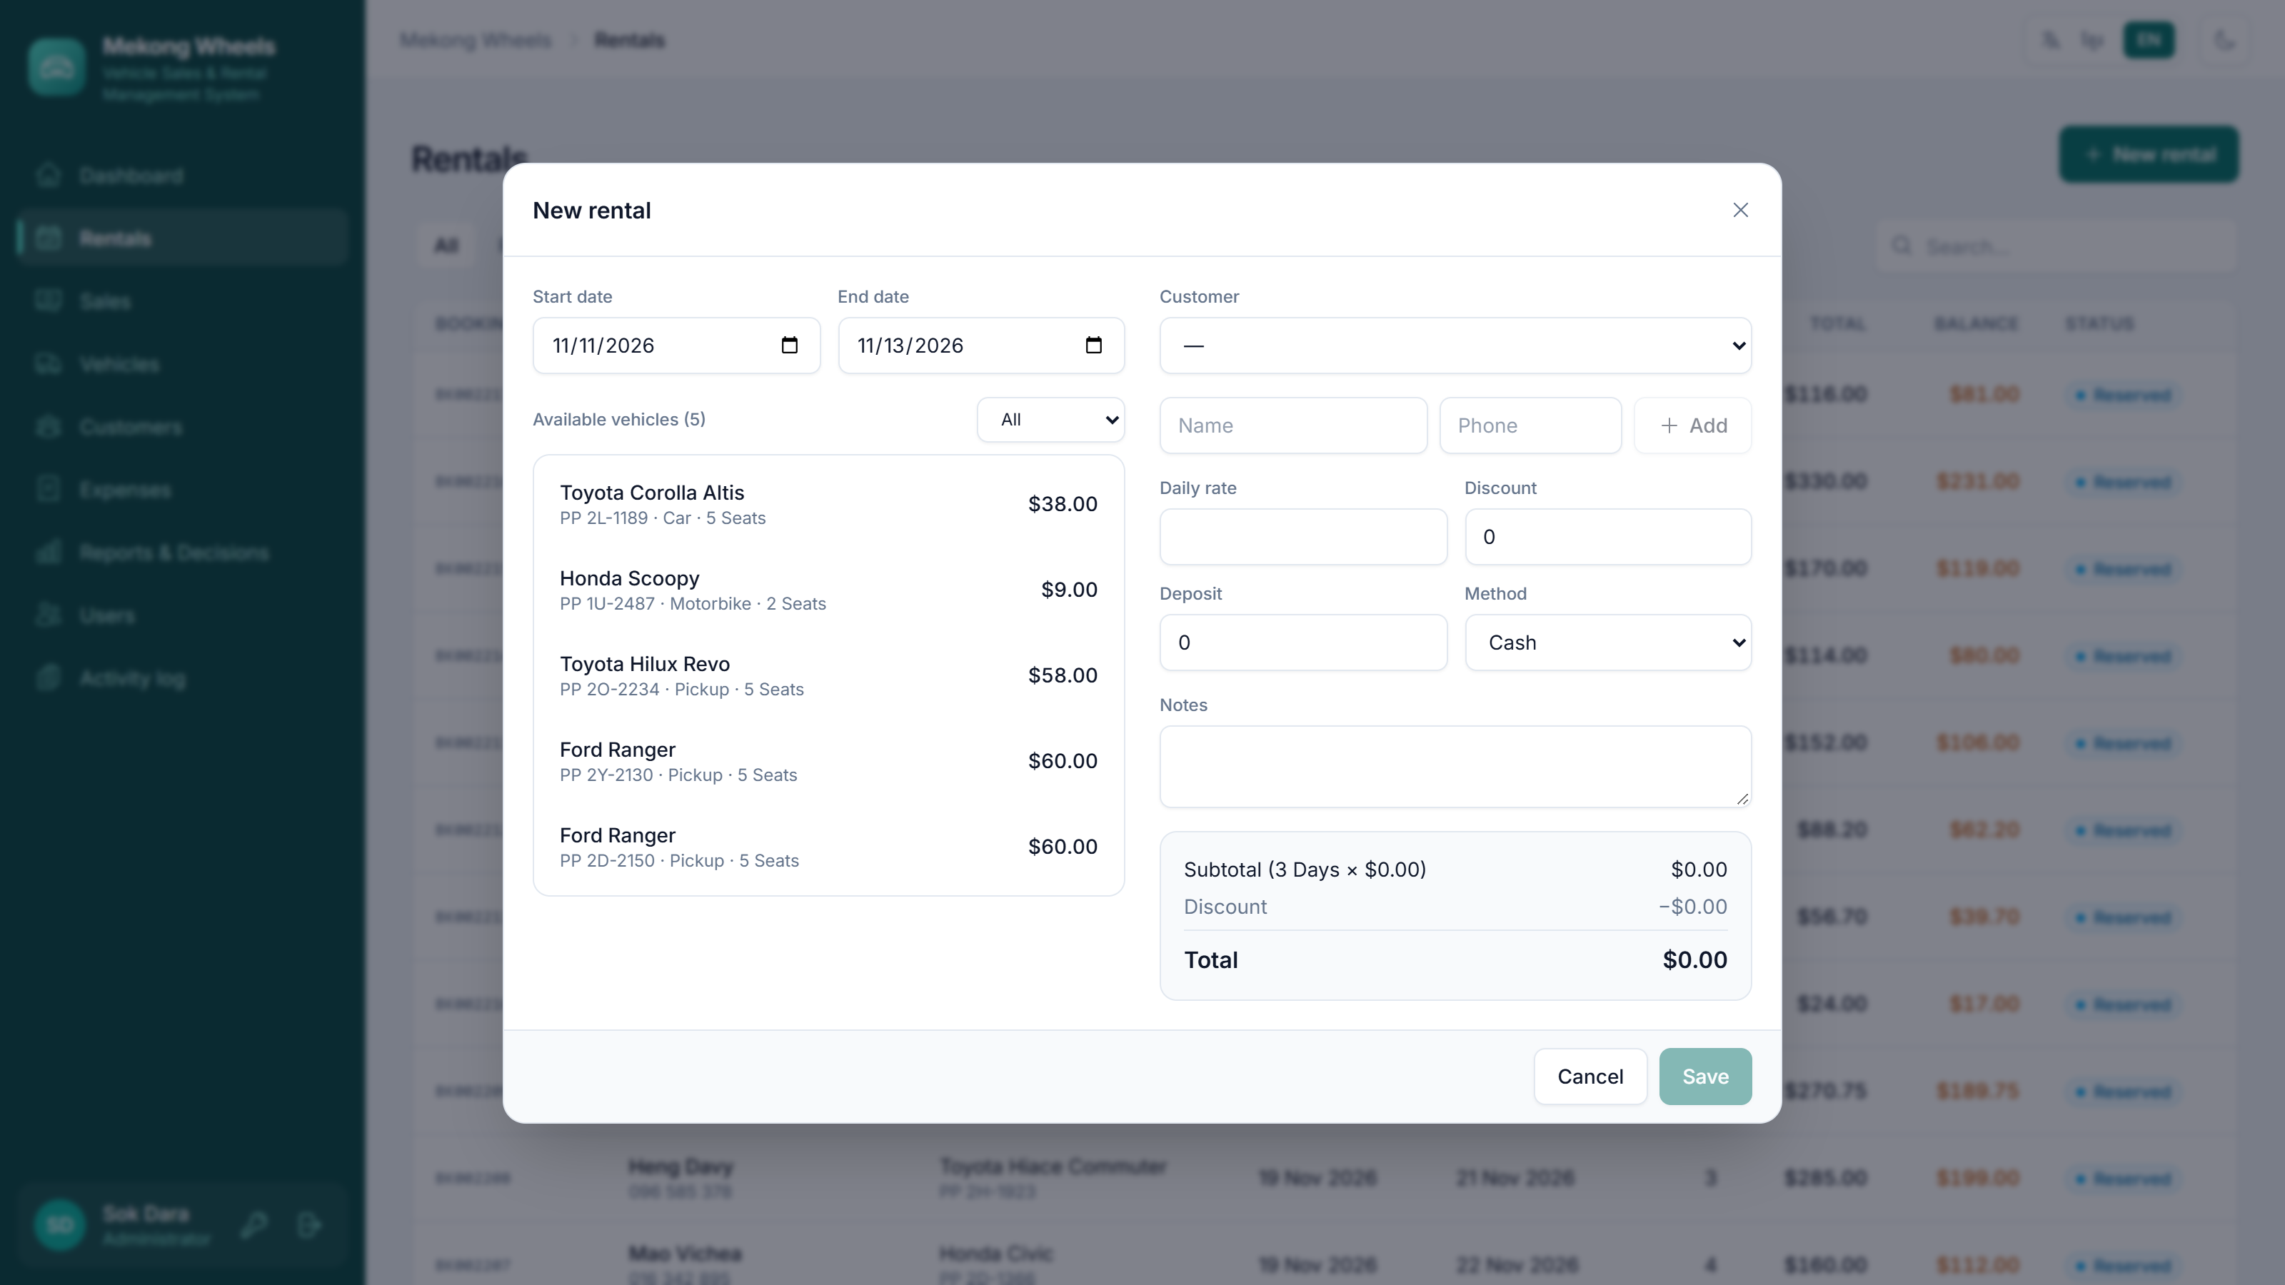
The rental life cycle the system manages
1
Book
2
Pick up
3
Return
4
Payment
5
Reports
Only free vehicles are shown
Mileage recorded · status “On rent”
Late fee calculated automatically
paid / balance on every booking
Dashboard updates instantly
Rules the system enforces automatically
Rental days
= end date − start date + 1
Late fee
= days late × daily rate
Double booking
Refused (vehicle not offered)
Overpayment
Refused (balance never negative)
Notes:
A rental goes through five steps. When booking, the system only offers vehicles that are free for those dates, so double bookings are impossible. When a vehicle comes back late, the system calculates the late fee itself.

Slide 8
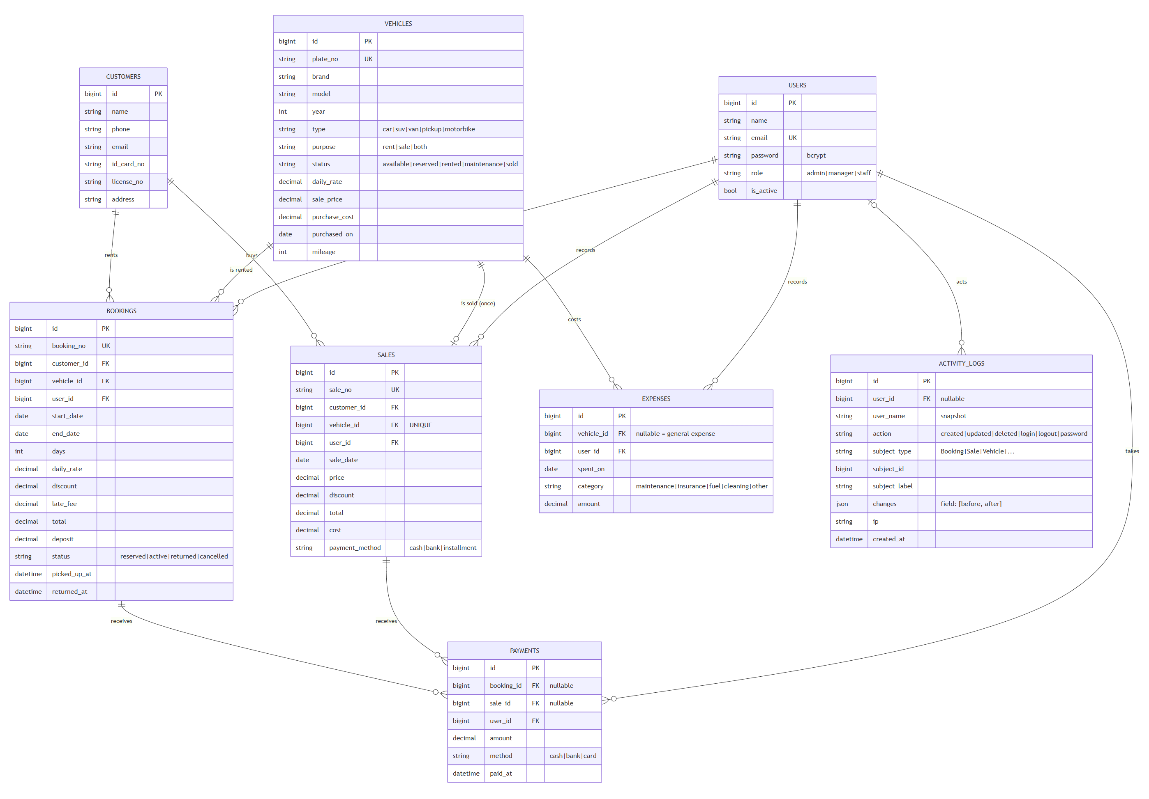
Database design (ERD)
8
tables · Normalization 3NF
6 core
customers, vehicles, bookings, sales, payments, expenses
Security
users (roles) + activity_logs (audit)
Deliberate exception
daily_rate and cost are stored at transaction time — later price changes do not rewrite history
Notes:
The database has 8 tables: 6 core tables plus users and activity_logs. We store the daily rate and the cost at the time of each transaction, so editing a vehicle price later does not change history or profit.

Slide 9



Which vehicle type should we invest in?
12 months of system data: 1,884 rentals · 18 sales · $50,761 expenses · Dec 2025 – Nov 2026
40%
35%
25%
ROI
Utilization
Profit / vehicle
How much profit each $1 invested earns
High = demand exceeds supply → a new vehicle will be rented at once
How many dollars one more vehicle adds
Score = 100 × (0.40 × ROI/max ROI + 0.35 × Util/max Util + 0.25 × Profit per vehicle ÷ max)
Notes:
This is a non-routine decision that a DSS supports. We compare vehicle types on three weighted criteria, each scored relative to the best type.

Slide 10
Answer: buy 2 SUVs and 1 van
71.9%
SUV utilization is the highest — ~99% in peak months (rentals turned away)
$18,886
profit per vehicle per year — a new SUV pays back in ~2.2 years
43%
of all rental revenue comes from just 7 SUVs
Do not buy more: cars and pickups (ROI 22–28%) · motorbikes: high ROI but little total profit
Notes:
SUVs win with a score of 88.8, with vans close behind at 88.1. SUV demand exceeds supply: around Khmer New Year and Pchum Ben almost none are free. Motorbikes have the highest ROI but little profit per vehicle, and the existing ones are not fully rented yet.

Slide 11
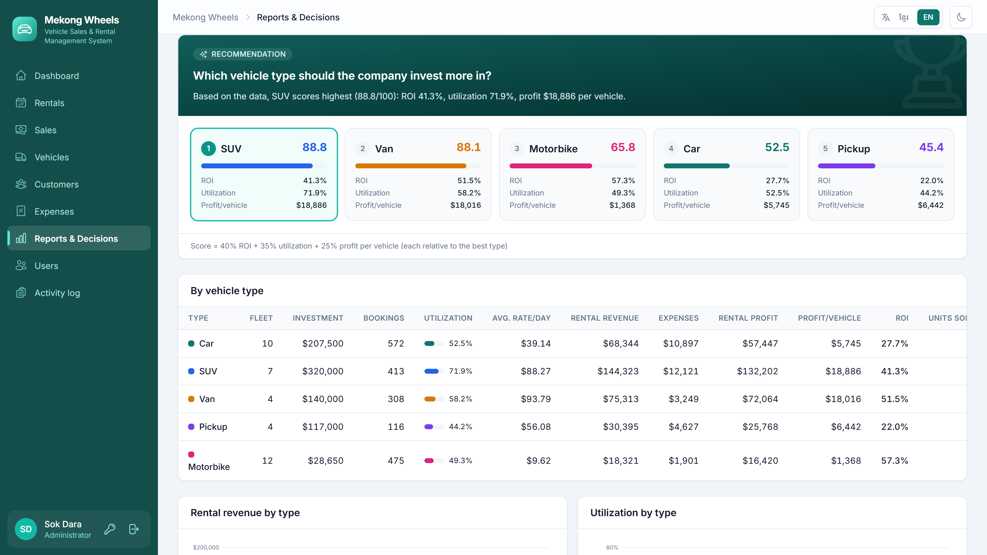




The “Reports & Decisions” screen in the system
Any date range
Ranking + automatic recommendation
Detailed table per vehicle type
One-click Excel export
Notes:
These figures are not calculated by hand: a manager opens this screen, picks a period and sees the recommendation at once. We will show this screen live in the demo.

Slide 12
Monthly trend: clear seasonal peaks
April (Khmer New Year) and Sep–Oct (Pchum Ben)
Rentals rise 40–70% → raise prices 10–15% in peak months and run rainy-season promotions
File 04-excel-dashboard.xlsx
Dashboard: 8 KPIs + 5 charts
Moving average, MoM, Trendline
31,516 formula cells — no errors
What-if: change the weights → the ranking changes
Orange = peak months · November (10 days) not included
Notes:
The Excel file is generated from the database and every figure is a formula. The trend shows clear seasons: Khmer New Year and Pchum Ben. Try the what-if: weighting only ROI puts motorbikes first, so the decision depends on the business goal.

Slide 13
Booking: from manual (As-Is) to automated (To-Be)
As-Is
9 manual steps · 3–4 documents · ~10 min per booking · reports 1–2 weeks late
Customer asks
by phone
Check the book
by eye
Write booking
+ invoice
Call to check
the car is there
Count late days
by hand
Type into Excel
at month end
Red boxes = weak points: double bookings, missed late fees, duplicate data entry
To-Be
Enter once · < 30 seconds · overlapping bookings refused · instant reports
Enter dates →
see free cars only
Pick car + customer
→ Save
Click “Pick up”
/ “Return”
Dashboard & Reports
automatically
Next phase: Online booking / Telegram bot · ABA KHQR payments · return reminders · mileage-based maintenance
Notes:
The old process has nine manual steps, and the red boxes are where errors happen. The new process has four steps, and the error-prone parts (checking availability, late fees, reports) are done by the system.

Slide 14
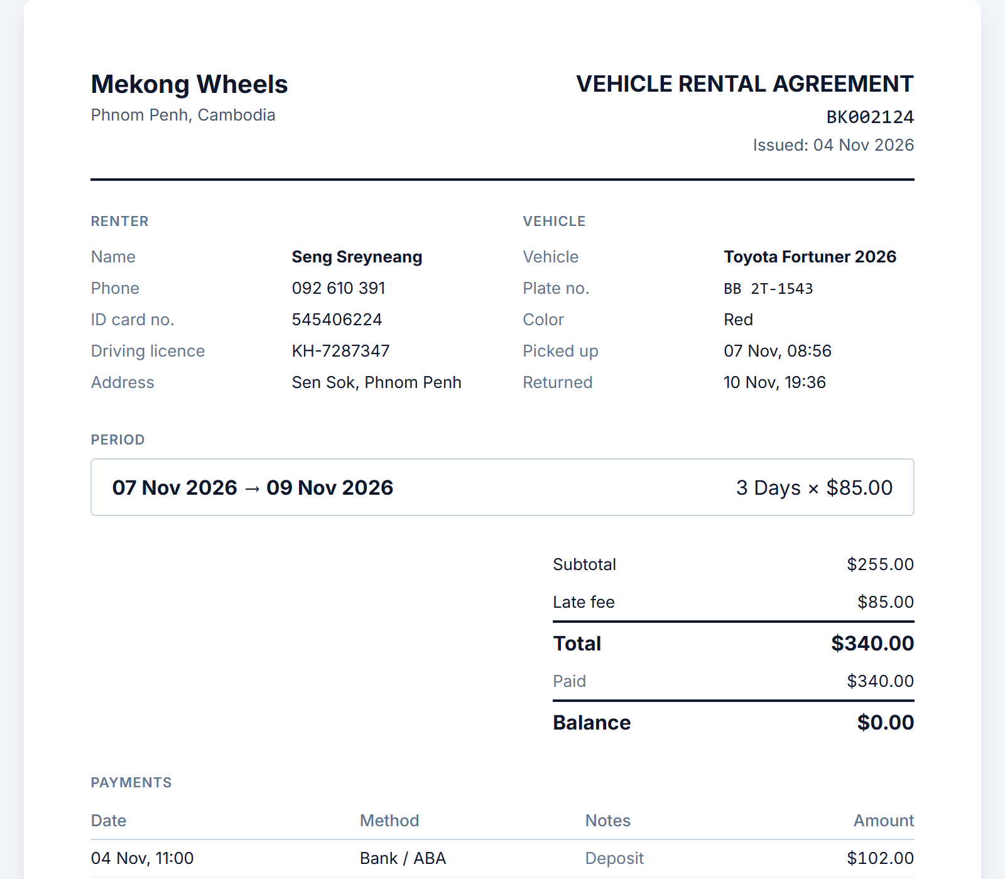
Live system demo
1
Sign in
Admin · Manager · Staff — each sees different screens
2
Book a vehicle
Try an overlapping booking → refused
3
Pick up → late return
Late fee calculated automatically
4
Print the contract
A4 · Khmer / English · Save as PDF
5
DSS report
Recommendation + Excel export
6
Khmer / EN · Dark mode
Switchable on every screen
Notes:
About five minutes of demo. Tip: record a video of the demo in advance in case the computer or internet fails. Sign in as admin@rental.test / admin123 (demo data).

Slide 15
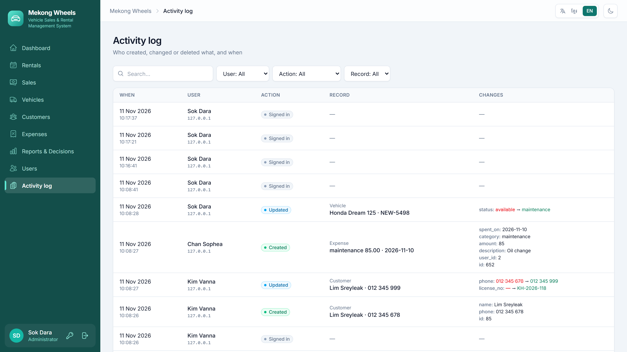



Quality and security
61
automated tests
Backend 27 + Frontend 34
3
permission levels
Admin · Manager · Staff
Daily
Automatic backup
Keeps the last 30 copies
Audit log: who created, changed or deleted what, and when (before → after)
Notes:
The system has 61 automated tests that protect the business rules. Permissions are checked on the server. The audit log shows who changed what, and backups run every day, so it is ready for real use.

Slide 16

Thank you
Conclusion
TPS
Bookings, sales, expenses — entered once
MIS
A daily dashboard instead of month-end Excel
Questions and feedback
DSS
Data-driven investment: SUVs + vans
Ready for real use
Permissions · Audit log · Backup · HTTPS
Mekong Wheels · MIS
Notes:
In summary: one system fixes the booking problems, gives daily reports and supports investment decisions. Thank you — we are happy to take questions.

